Slide 1



Slide 2
String Matching
Target String: HPC Project
Random String Took 640 Iterations to achieve the target string

Slide 3
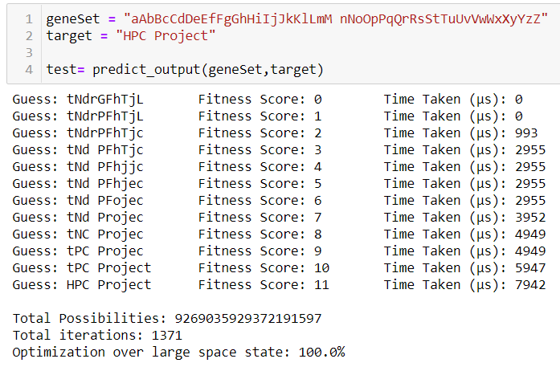
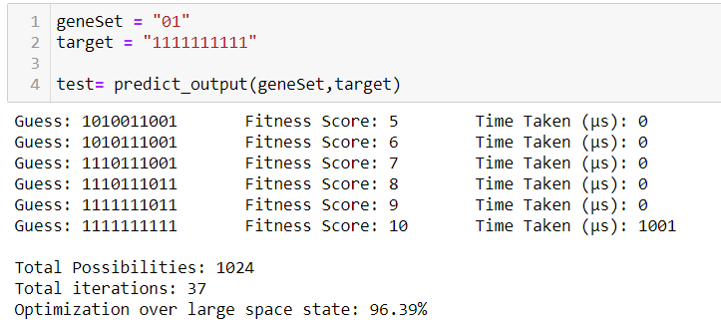
String Matching
Huge Optimization% can be achieved for long strings
Time taken to guess is significantly less using Genetic Algorithm

Slide 4
Traveling Salesman Problem (TSP)
Selected 40 locations at random
Optimized distance between points using Genetic Algorithm

Slide 5
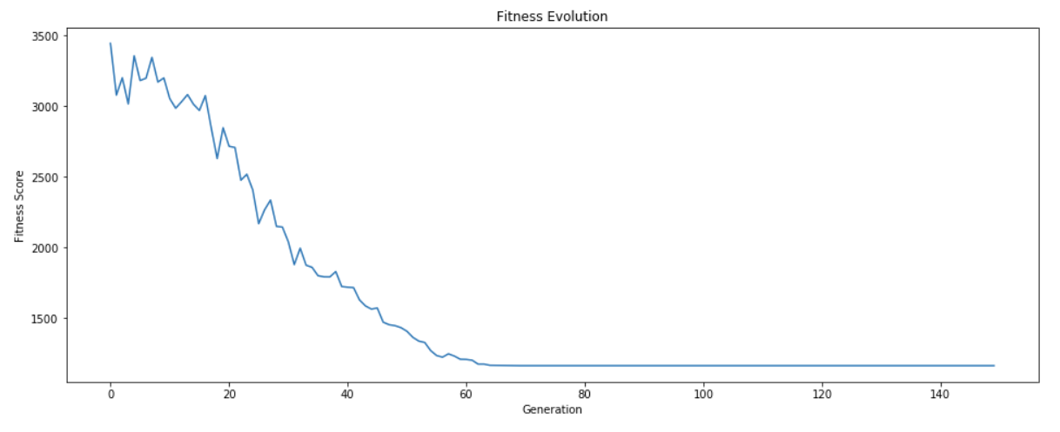
Traveling Salesman Problem (TSP)
Lower the fitness score, better the point selection.
As generation increases, fitness score decreases.

